Slide 1
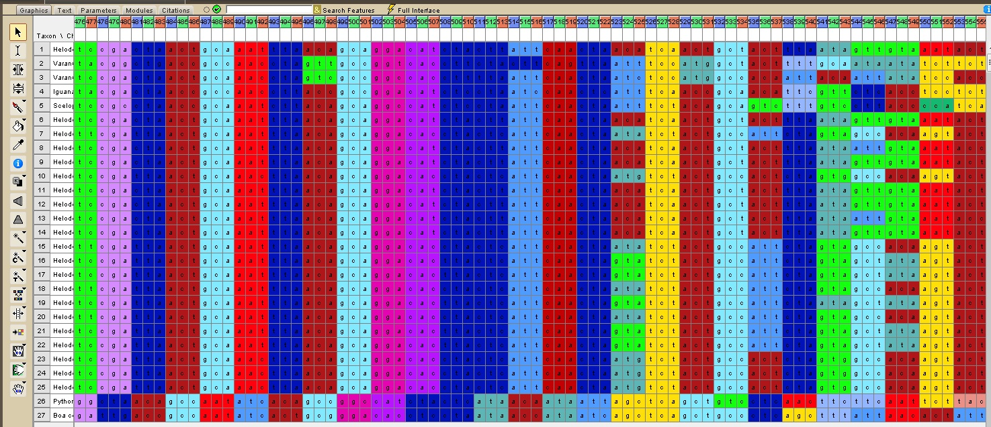
Lab 3: Sequence Alignment and Homology
BIOL 4174/5174: Conservation Genetics Lab
2/7/2018
Slides stolen shamelessly from Steve Mussmann’s 2016 Conservation Genetics course and Jeff Silberman’s 2012 Molecular Phylogenetics course

Slide 2
FIRST update class materials: git pull
/Users
A shortcut to your home directory is ~/
/ConsGen
Other user accounts
/Desktop
/Documents
/Downloads
/local
/username
/ConsGen2018
We want to cd to this directory:
~/Desktop/username/ConsGen2018

Slide 3
SECOND: Run lab3_setup.sh
Change directories to: ~/Desktop/username/ConsGen2018/Lab3
Run setup script:
./lab3_setup.sh
source ~/.bash_profile
What this will do:
Install programs needed for lab 3
Modify your “bash profile” to make these new programs accessible and add colors to “ls” output
Print nice cat picture for encouragement

Slide 4
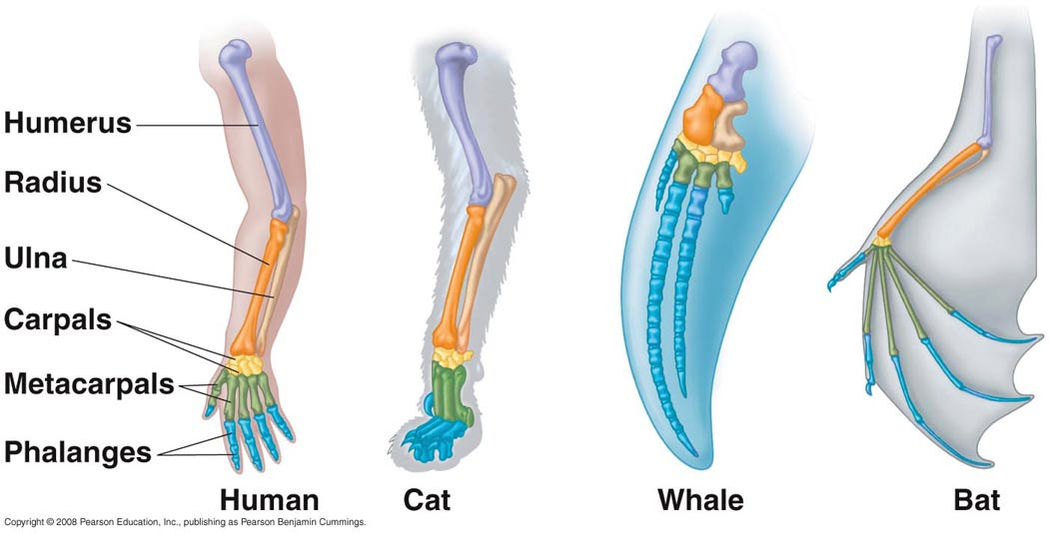
Homology
Homolog: Identity or similarity due to common ancestry
Features in different taxa are homologous if their similarity is a result of common ancestry

Slide 5
Arm structures homologous although superficially different, reflecting modification of ancestral structures
Bird and bat wings: Homologous as forearms, NOT homologous as wings (common ancestor could not fly)

Slide 6
When two species have identical character states, this may reflect:
HOMOLOGY: Both species inherited that character state from a common ancestor
HOMOPLASY: The similarity evolved indepentendly in the two species; similarity NOT due to common ancestry
*Only homologous similarity reflects common ancestry*

Slide 7
Two basic sources of homoplasy:

Slide 8
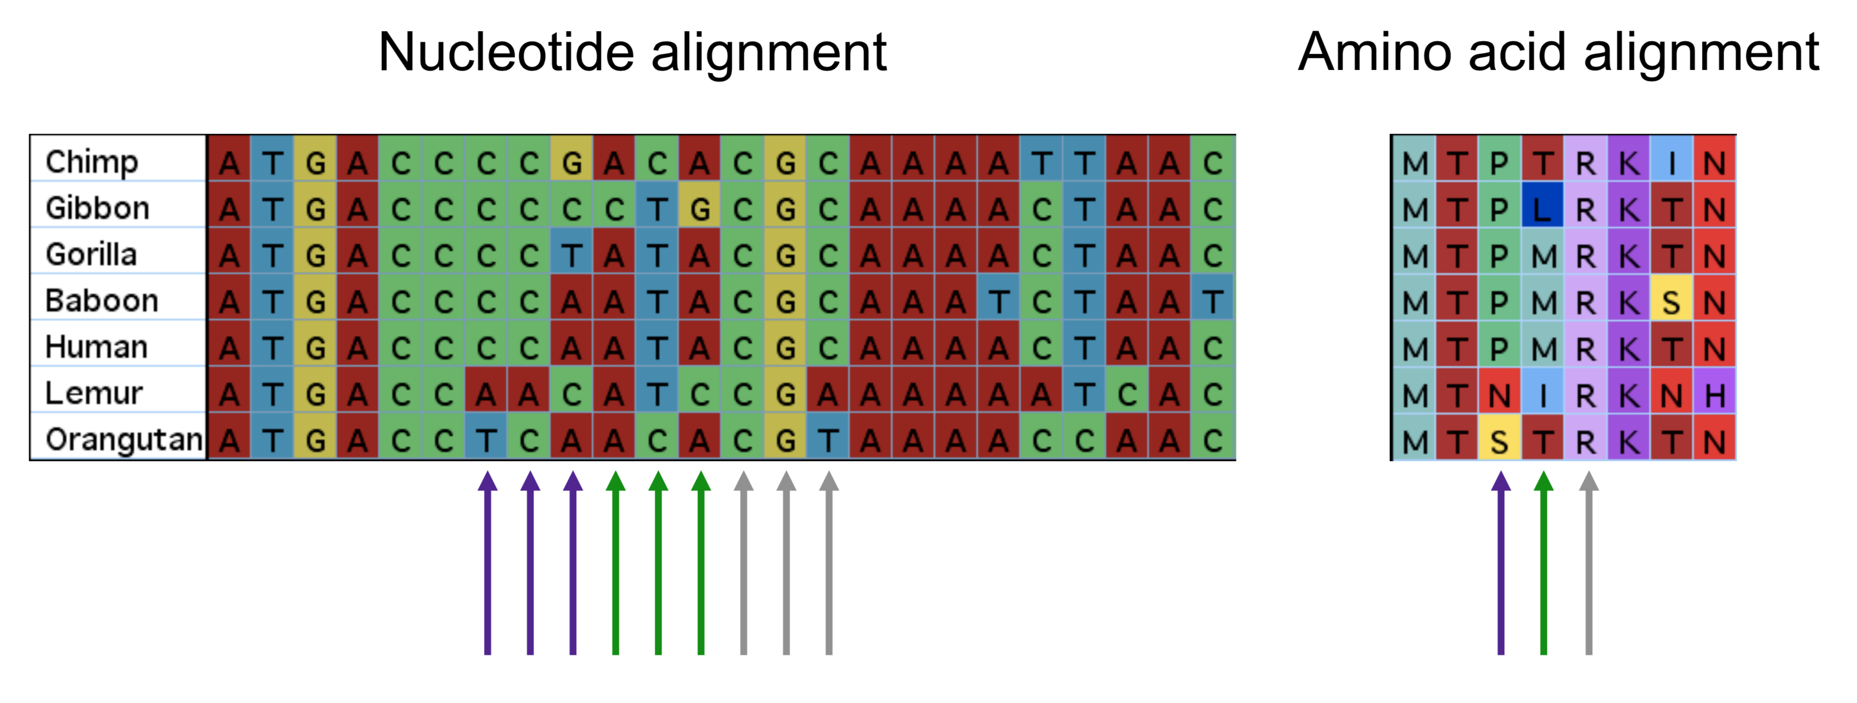
Molecular Homology: Sequence alignment
Statement of homology at level of:
Individual nucleotide in DNA sequence
Amino acids (in coding genes)

Slide 9
**Important: Homology is a hypothesis**

Slide 10
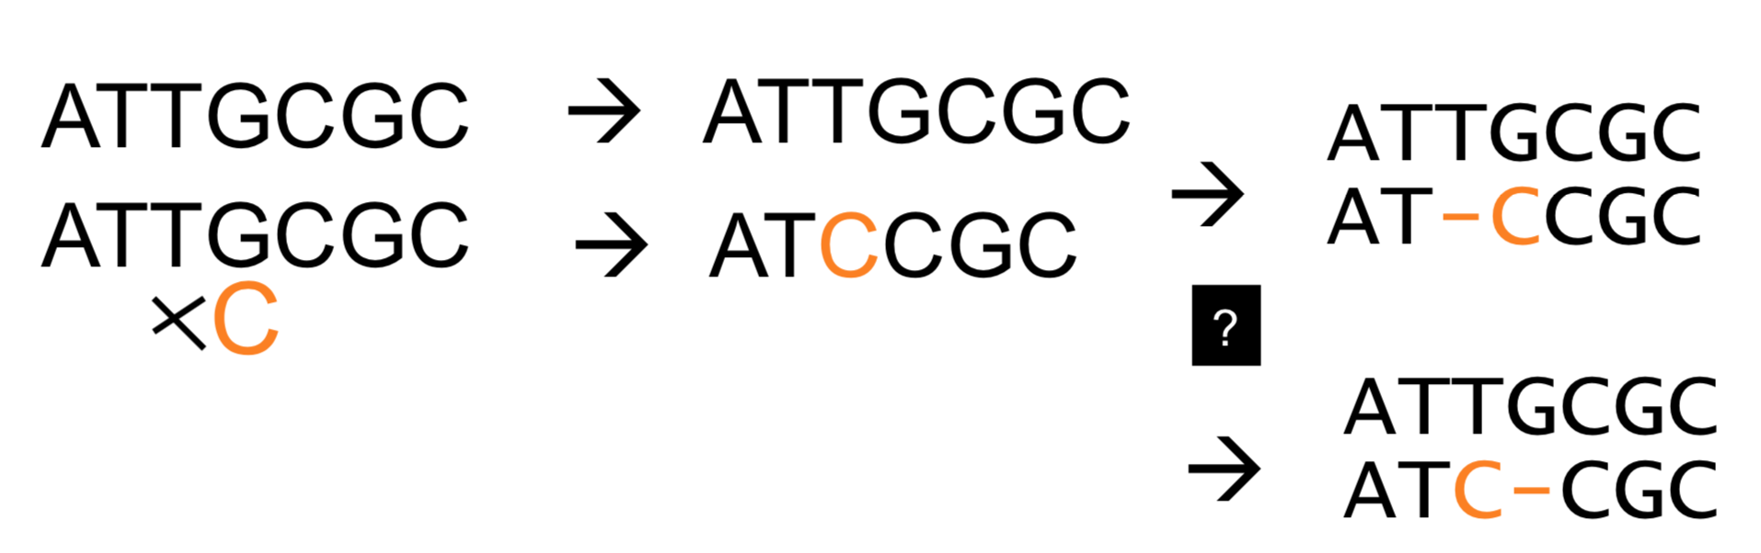
The correct alignment??

Slide 11
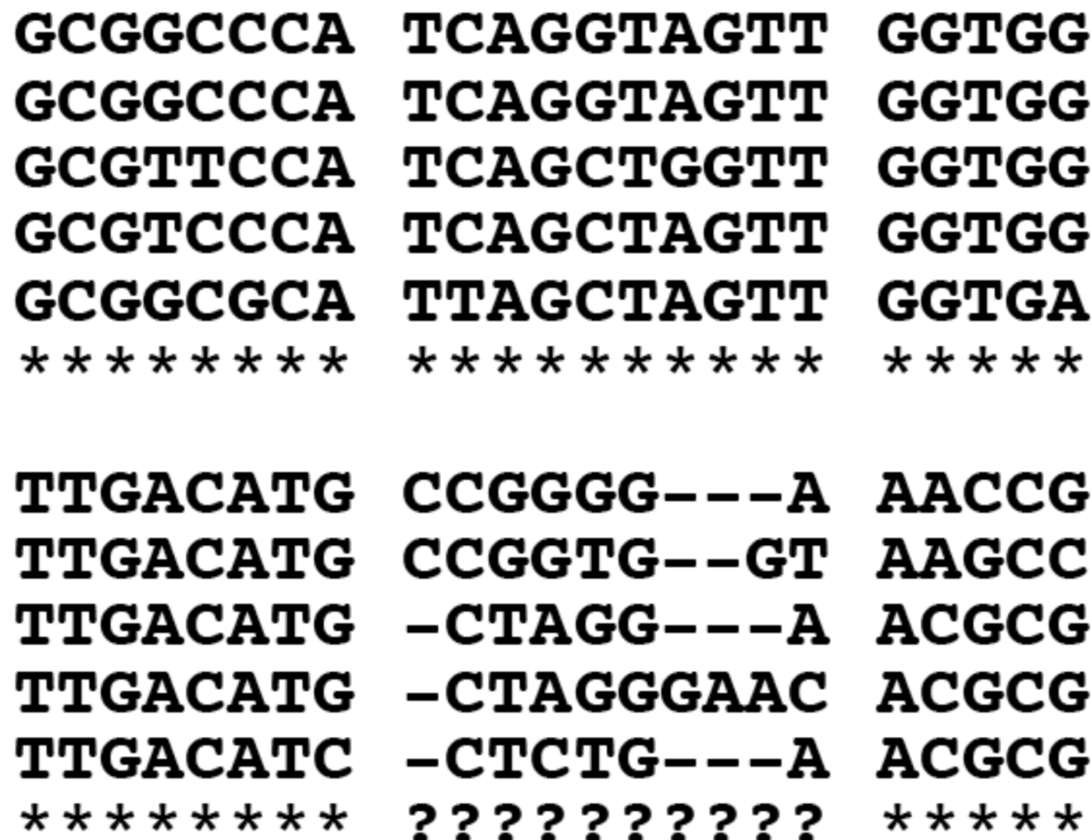
Sometimes easy… Sometimes not easy
Easy
Lots of indels, not easy

Slide 12
Alignment algorithms: Comparing two sequences
Local vs. Global Alignment
Local alignment = comparing subsequences
Can be used to align conserved parts of two genomes
Used in BLAST to find similar sequences
Global alignment = comparing sequences from end to end to see how similar they are.
Used in multiple sequence alignment of single genes

Slide 13

Local alignment: BLAST
Basic Local Alignment Search Tool
Looks for statistically significant similarities between many sequences
BLAST algorithm first published in 1990 (Altschul et al., Journal of Molecular Biology)

Slide 14
The BLAST algorithm is a heuristic algorithm
Heuristic = method of problem solving not guaranteed to give the optimal solution
Sufficient and efficient enough for the task at hand
Used when search space (possible solutions) very large (e.g. genetics)
Algorithm = step by step procedure or method for finding a solution to a problem
Heuristics:
Advantages:
Fast
Efficient
Disadvantages:
Might not find the optimal solution

Slide 15
BLAST basic algorithm
Seeding: Break query sequence into ‘words’
‘Word’ = short sub-string of nucleotides or amino acids
Default word size = 11
Search words against database of sequences
When it finds a match, tries to ‘extend’ the alignment out
During extension: Penalties for gaps and mismatches

Slide 16
Typical usage of BLAST
Typically used with NCBI Genbank
Located at http://www.ncbi.nlm.nih.gov/genbank/
Collection of all publicly available nucleotide sequences
BLAST + Genbank allows you to:
Identify species of origin for an unknown sequence*
Find homologous sequences from related species
Map chromosomal position of an unknown gene
Generate hypothesis of function for an unknown gene
Comparing sequences

Slide 17
Caveats for species identification, or “DNA barcoding” (also eDNA)
Can only succeed when:
All possible ”species identifications” are present in the database
You can trust all of those identifications
Unsampled “cryptic species” do not exist
You can trust an arbitrary “match” threshold (e.g. 0.5% different = same species? 1%? 2%?)
Ancestry at your gene/locus matches rest of genome
Etc…
*The Point™ → Be aware of the assumptions you are making!

Slide 18
Multiple Sequence Alignment (MSA)
MSA = aligning >2 sequence simultaneously
Various approaches
Automated (fast)
Manual (tedious)
Combination (best)

Slide 19
Automated MSA also uses heuristics!
Why?
Exhaustive pairwise alignment → Compare ALL sequences to each other
Complexity increases exponentially with n=number sequences and linearly with m=sequence length.
Impractical with even >10 sequences
Instead, MSA employs heuristics to focus on paths that seem more likely

Slide 20
Popular Programs for Automated MSA
ClustalX, ClustalW – Progressive alignment (Larkin et al. 2007; Thompson et al. 1994)
No longer being updated
Also accessible through many other programs
Geneious, Mesquite, BioEdit, MEGA
Clustal Omega – (Sievers et al. 2011)
Originally developed for aligning amino acid sequences
Recently added DNA/RNA alignment capabilities
Command line only
Muscle – Iterative alignment (Edgar 2004)
Developed by a former physicist
Profile-profile alignment, iterative method

Slide 21
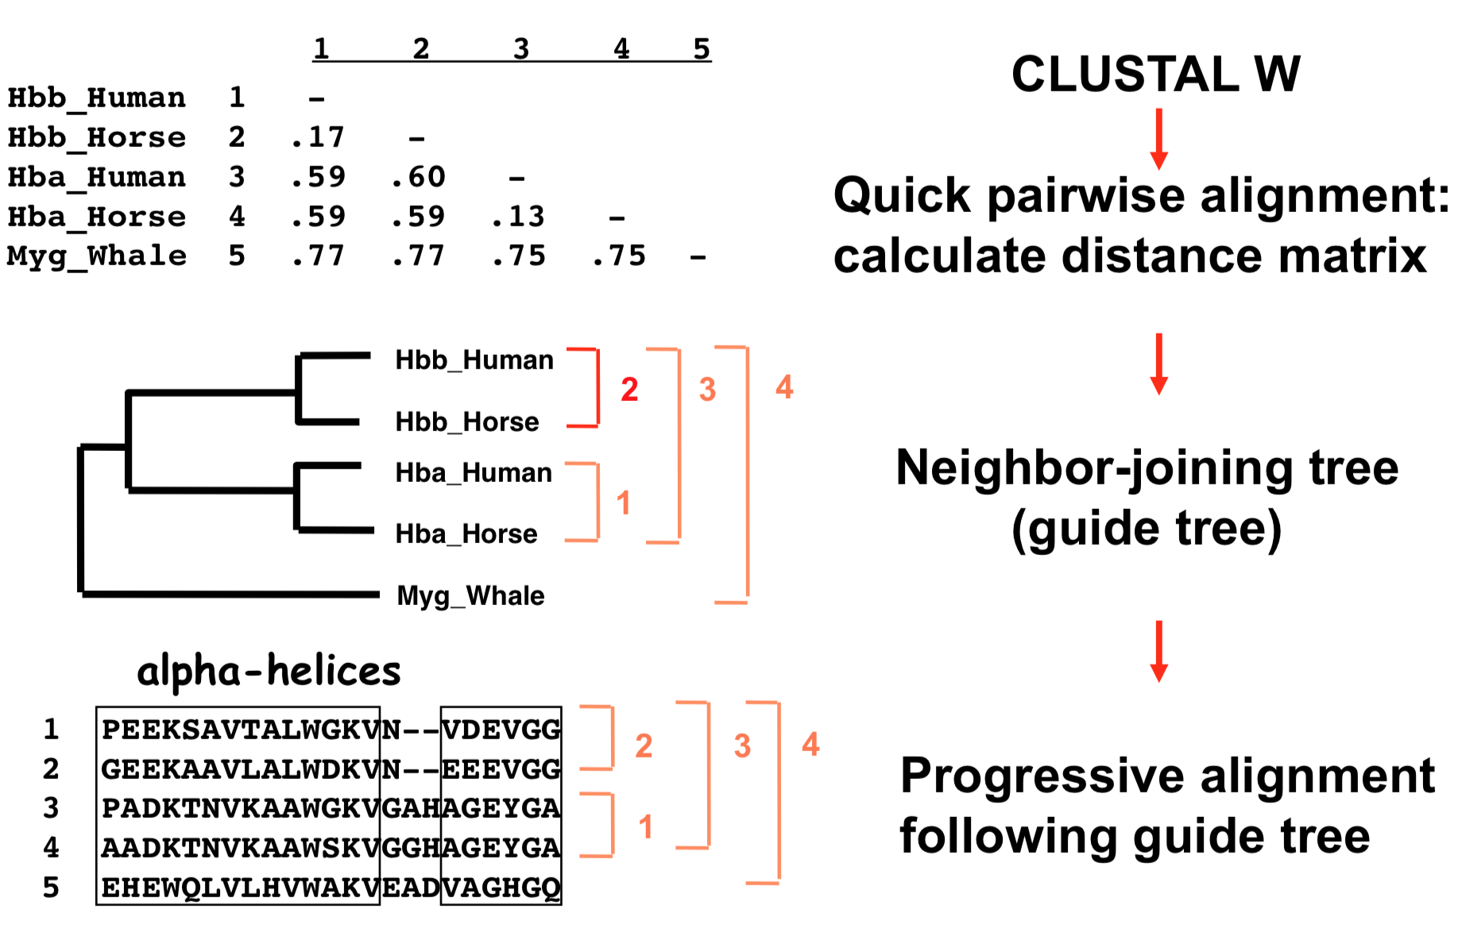
Clustal W/X Algorithm

Slide 22
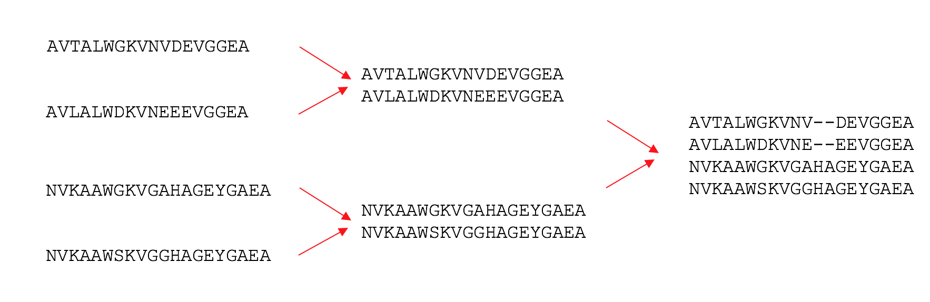

Clustal Uses “Progressive Alignment”
The sequences are aligned progressively (global or local algorithm):
alignment of 2 sequences, create profile (consensus)
alignment of 2 profiles (groups of sequences)

Slide 23
Clustal W/X Limitations
Clustal W/X is not optimal
There are known areas where it performs poorly:
No “refining step” so early errors cannot be corrected
If distance-based guide tree is bad, alignment can be bad
Fundamental principle of data analysis: Garbage In = Garbage Out

Slide 24

Clustal Omega
Very different from ClustalX / W but still a progressive alignment algorithm
Uses better method of estimating guide tree
Uses a Hidden Markov Model (HMM)
The short explanation: this involves probability theory, and estimating probability of observed and hidden states
Can align hundreds of thousands of sequences

Slide 25
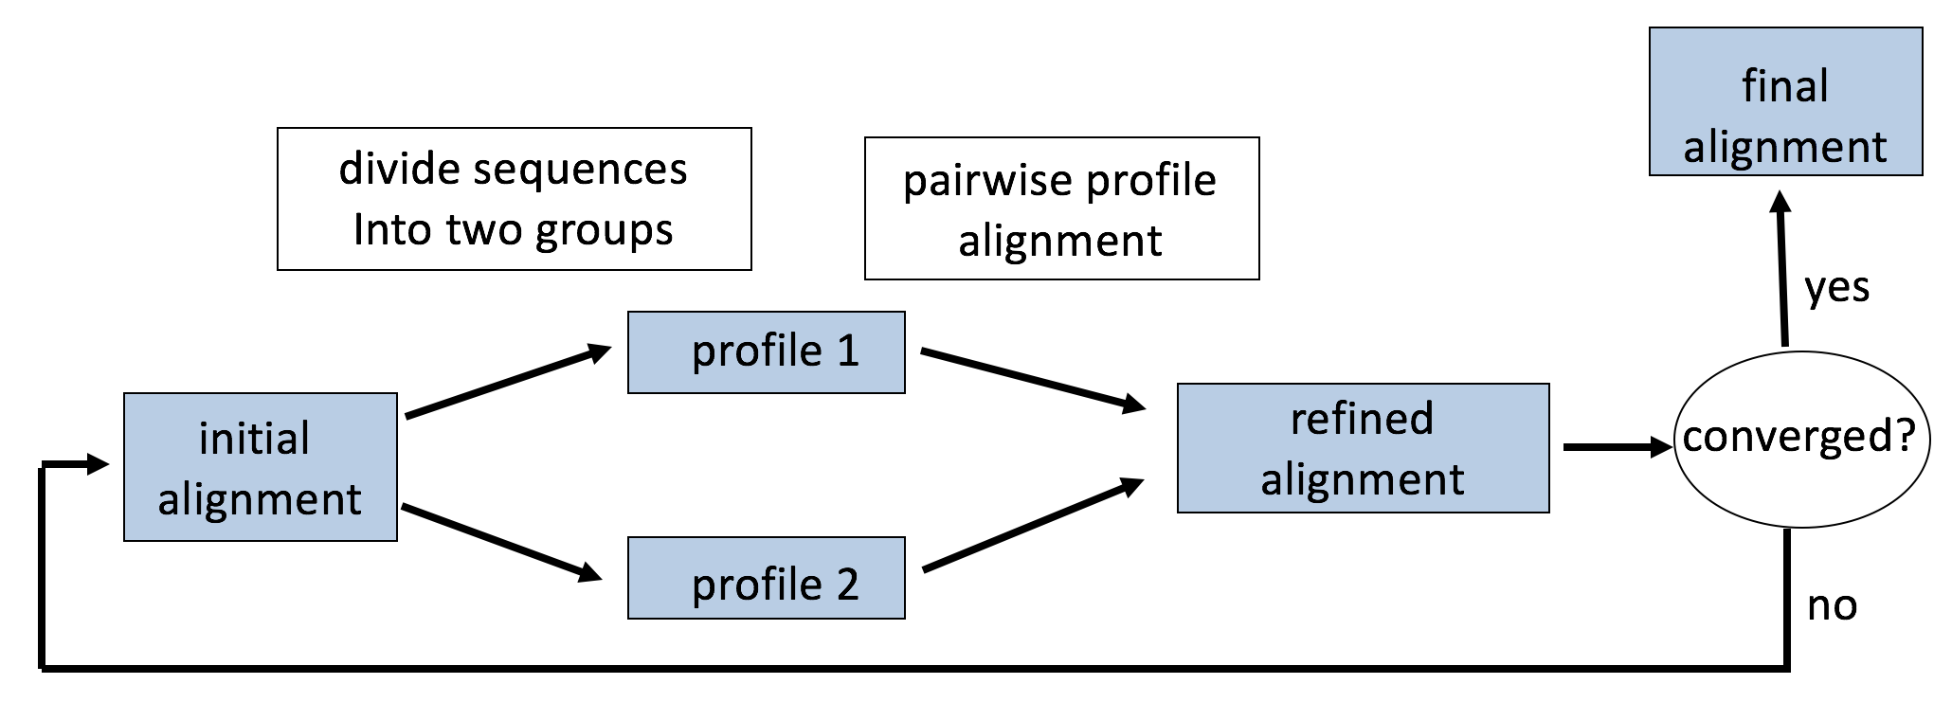
MUSCLE (Multiple Sequence Comparison by Log-Expectation)
Iterative method: Compute sub-optimal solution, and keep modifying that intelligently until solution converges

Slide 26
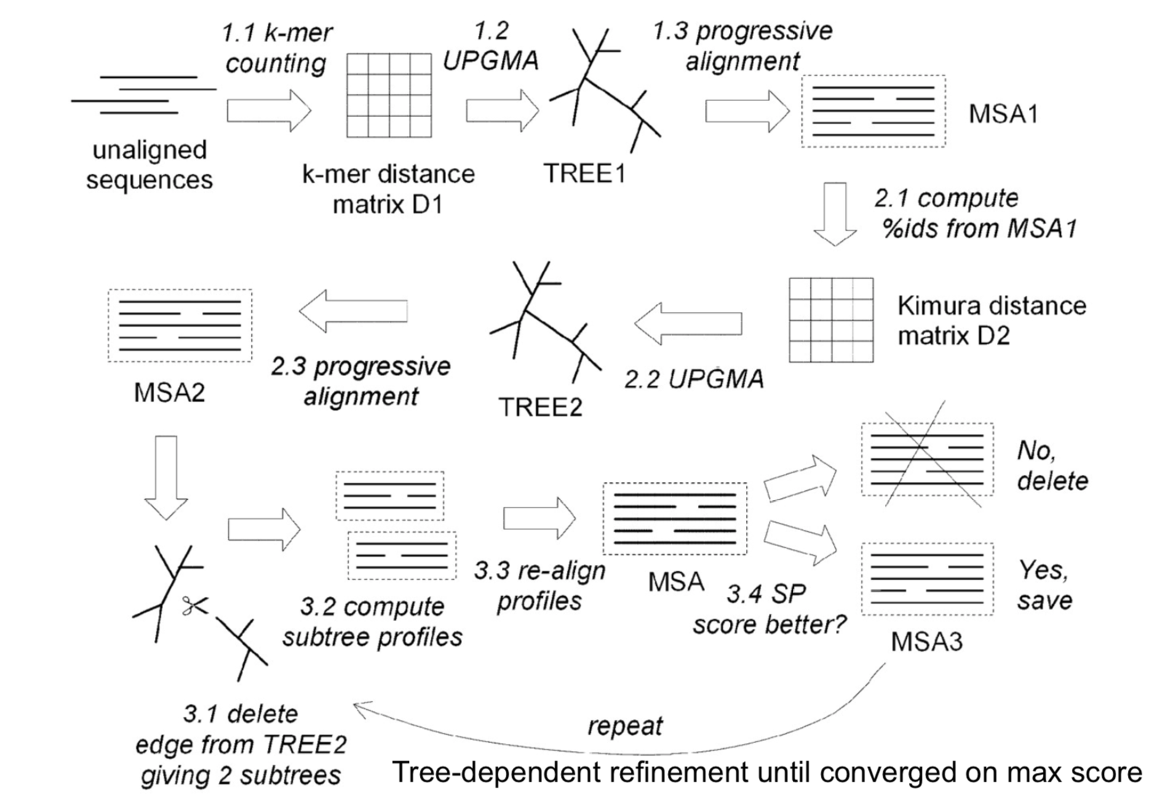

Slide 27
Whatever algorithm you use, ALWAYS visually inspect your alignment

Slide 28
Final notes
Computer algorithms make mistakes
Use your knowledge of biology
Use your knowledge of sequence evolution
…But don’t overthink it
Homology is the end goal – If homologous bases not aligned, you can have weird results in analyses
Uncle Steve says “Garbage In = Garbage Out”

Slide 29
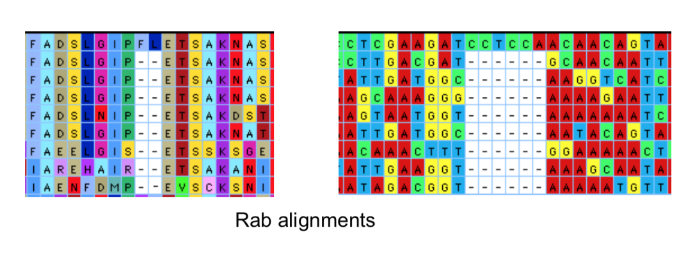
Aligning coding regions
When aligning coding DNA, use AA translations to your advantage

